Slide 1

IT Ticket Analysis
Mr. Ayush Porwal
21/12/2024

Slide 2
About IT Ticket Analysis
Introduction:
The IT support ticket management system plays a crucial role in resolving technical issues within an organization. Effective management of IT tickets ensures timely resolution, satisfied employees, and efficient use of resources.
In this analysis, we focus on the performance of IT agents, the efficiency of ticket resolution, and overall employee satisfaction.
Objectives:
Identify high and low performers among IT agents based on resolution time and satisfaction ratings.
Assess ticket resolution efficiency to highlight areas needing improvement.
Analyze employee satisfaction to determine how well the IT support system meets user needs.
Provide data-driven recommendations for hiring, firing, or training decisions to enhance team performance.

Slide 3
Data Overview
Dataset Summary:
The dataset consists of two main sheets: Tickets and IT Agents.
Tickets Sheet: Contains information about IT support tickets, such As: Ticket ID, Date (Fecha), Employee ID, Agent ID
Request Category (e.g., Login Access, System, Software)
Issue Type (e.g., IT Error, IT Request), Severity, Priority
Resolution Time (in days), Satisfaction Rate (1-5 scale)
IT Agents Sheet: Contains agent information, such as:
Agent ID, Full Name, Email, Date of Birth (Year, Month, Day)
Key Data Points:
Total Tickets: 97,498
Total IT Agents: 50
Satisfaction Ratings range from 1 (low) to 5 (high)
Resolution Times vary based on the request category, issue type, and agent performance

Slide 4
Methodology
Data Cleaning:
Removed Duplicates: Got rid of any repeated records.
Handled Missing Values: Fixed missing information by either filling it in or deleting the affected rows.
Standardized Data: Made sure dates and categories were consistent
Analysis Techniques:
Basic Statistics: Calculated important numbers like average resolution time and ticket volume.
Trend Analysis: Looked at how ticket numbers changed over time using charts.
Comparison: Compared how well different agents performed.
Tools Used:
Used Excel features like:
Pivot Tables: To summarize and analyze data.
VLOOKUP: To find agent information based on their IDs.
Charts: To create visuals for easier understanding.

Slide 5
Overview of Dataset Attributes and Quality
Content:
Total Number of Attributes In Ticket Table is 10 and in IT Agent Table is 6
Missing Values Count is 0 (No missing or inconsistent values)
Key Takeaways:
The dataset is well-structured with no missing values, ensuring reliable analysis.
Understanding the attributes helps clarify the dataset's scope for further analysis.
IT Agent Table
Attribute | Description
Agent ID | Unique identifier for the agent.
Full Name | Agent's full name.
Email | Agent's email address.
Year of Birth | The year the agent was born.
Month of Birth | The month the agent was born.
Day of Birth | The day the agent was born.

Slide 6
Ticket Table
Attribute Name | Description
ID Ticket | Unique identifier for each ticket
Fecha | Date the ticket was created.
Employee ID | ID of the employee who submitted the ticket.
Agent ID | ID of the agent handling the ticket.
Request Category | Category of the request (e.g., Login Access).
Issue Type | Type of issue (e.g., IT Error).
Severity | Severity level of the issue.
Priority | Priority level for ticket resolution.
Resolution Time (Days) | Time taken to resolve the issue.
Satisfaction Rate | Employee satisfaction rating (1-5).
Severity Number | Numerical severity rating.

Slide 7
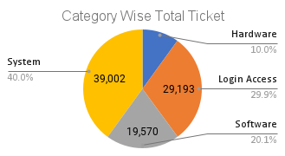
Ticket Volume For EACH Category
Content:
Distribution of Ticket Categories:
System: 39,002 (40.00%)
Login Access: 29,193 (29.94%)
Software: 19,570 (20.07%)
Hardware: 9,733 (9.98%)
Key Takeaways:
The System category dominates the ticket volume, indicating a primary focus area for support resources.
Understanding ticket distribution helps in identifying key areas for operational improvement and resource allocation.

Slide 8
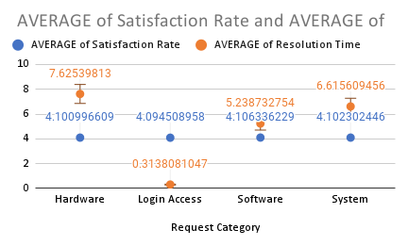
AVG. RESOLUTION TIME AND SATISFACTION RATE FOR Category
Content:
Login Access has the fastest resolution (0.314 days), while Hardware takes the longest (7.625 days).
Software has the highest satisfaction rate (4.106), with System close behind (4.102).
Key Takeaways:
Reduce resolution times for Hardware and System.
Use Login Access efficiency as a benchmark for other categories.

Slide 9
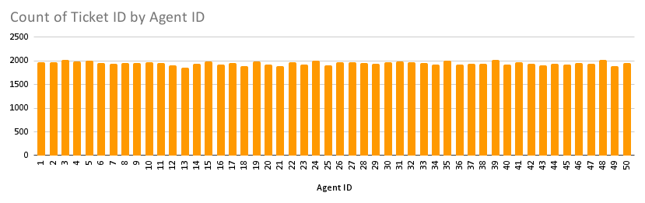
Agent Wise Ticket Handle
Content:
Agent 39 handled the highest number of tickets (2,026), showcasing high workload management.
Agents 48 and 24 also managed over 2,000 tickets each, maintaining competitive resolution and satisfaction rates.
Key Takeaways:
Focus on supporting high-performing agents like 39, 48, and 24 to sustain their productivity and quality.
Analyze workloads and distribute tickets more evenly among agents to prevent burnout and improve efficiency.

Slide 10
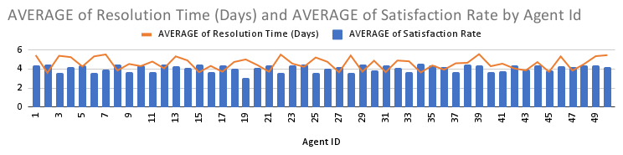
Agent WISE Resolution Time & Satisfaction Rate
Content:
Agent 2 has the best satisfaction rate (4.474) with a low resolution time (3.597 days), indicating efficient handling of tickets.
Agent 6 has one of the lowest satisfaction rates (3.593) despite a high resolution time (5.321 days), signaling areas for improvement.
Key Takeaways:
Recognize and reward agents like 2 for their efficiency and high satisfaction rates.
Provide targeted training for agents with high resolution times and low satisfaction rates to improve performance.

Slide 11
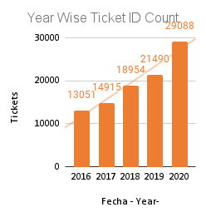
Yearly ticket volume trends
Content:
Ticket volume shows consistent growth, rising from 13,051 in 2016 to 29,088 in 2020, reflecting a 123% increase over five years.
The sharpest growth occurred in 2020, with a 35% jump from 2019, potentially influenced by changes in operations or increased user reliance on IT services.
Key Takeaways:
The upward trend in ticket volume highlights the need for enhanced scalability in IT operations to meet growing demand.
Analyzing yearly growth can guide proactive resource allocation and capacity planning strategies.

Slide 12
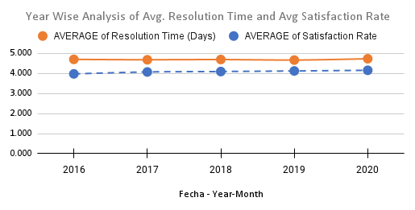
Avg. Resolution Time and Satisfaction Rate
Content:
Resolution Time Stability: The average resolution time remains relatively stable over the years, ranging between 4.52 to 4.59 days.
Satisfaction Rate Improvement: Customer satisfaction rates show a steady increase, improving from 3.98 in 2016 to 4.16 in 2020.
Key Takeaways:
the steady resolution time suggests consistent operational efficiency, but no significant reduction indicates room for further optimization.
The rising satisfaction rates highlight improved customer experience, likely due to better issue handling or communication strategies.

Slide 13
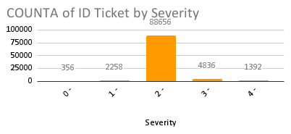
Ticket count by severity
Content:
Normal Severity tickets dominate with 88,656 tickets, reflecting the bulk of support requests.
Urgent Severity tickets, though fewer (1,392), have the fastest resolution time (2.001 days) with high satisfaction (4.119).
Key Takeaways:
Prioritize maintaining efficiency for Urgent Severity tickets while managing high volumes of Normal Severity tickets.
Analyze Minor and Major Severity tickets to identify opportunities for resolution time improvements.

Slide 14
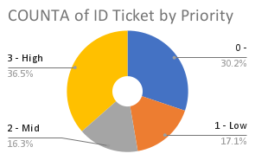
ticket count by priority
Content:
High Priority tickets are the most frequent (35,549), indicating a significant share of urgent issues.
Unassigned Priority tickets (29,410) represent a notable category, suggesting room for better categorization.
Key Takeaways:
Streamline processes to reduce the number of Unassigned Priority tickets and ensure efficient handling.
Allocate adequate resources to address the high volume of High Priority tickets promptly.

Slide 15
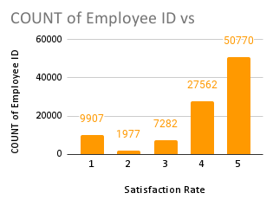
Employee Distribution by Satisfaction Rate
Content:
The majority of employees (50,770) reported a satisfaction rate of 5, indicating strong overall satisfaction.
Satisfaction rates of 1 and 2 are significantly lower, with a combined count of 11,884 employees, highlighting areas for improvement.
Key Takeaways:
Focus on maintaining high satisfaction rates, especially among the majority rating 4 and 5.
Investigate the causes behind low satisfaction rates (1 and 2) to enhance overall employee experience.

Slide 16
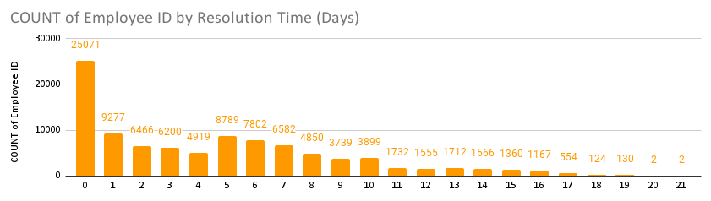
Employee Distribution by Resolution Time (Days)
Content:
A significant number of employees (25,071) resolved issues in 0 days, indicating high efficiency for simple cases.
Resolution times exceeding 10 days are rare, with very few employees handling such prolonged cases.
Key Takeaways:
Maintain and enhance processes that enable swift resolutions within 0–3 days to sustain efficiency.
Investigate prolonged resolution cases (10+ days) to identify and address underlying bottlenecks.

Slide 17
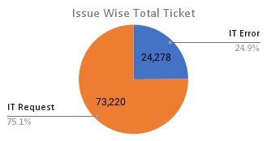
Tickets by Issue Type
Content:
IT Request tickets are the most frequent, with 73,220 tickets, indicating a higher demand for service requests.
IT Error tickets are significantly fewer (24,278), reflecting less frequent system-related issues.
Key Takeaways:
Focus on streamlining and optimizing the handling of the high volume of IT Request tickets.
Continue to monitor IT Error tickets to prevent potential system issues from becoming widespread.

Slide 18
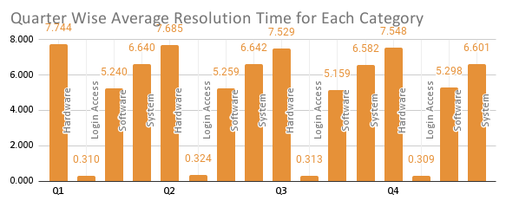
Quarterly Wise avg. resolution time by category
Content:
The analysis covers four quarters, highlighting the resolution times for Hardware, Login Access, Software, and System tickets.
Login Access consistently shows the shortest resolution times, while Hardware remains the most time-consuming request category.
Key Takeaways:
Hardware tickets consistently have the longest resolution times, averaging over 7 days each quarter.
Software and System tickets showed a slight increase in resolution times in Q4, indicating potential process bottlenecks during peak periods.

Slide 19
Enhance Agent Training Programs
Recommendation : Implement a comprehensive training program focused on common ticket issues and customer service skills.
Data-Driven Reasoning:
Low satisfaction rates linked to specific ticket types, indicating knowledge gaps.
Targeted training will help agents resolve issues faster and improve interactions.
Expected Impact:
Increased Customer Satisfaction: Enhanced agent skills leading to better satisfaction.
Reduced Resolution Times: Faster handling of tickets by better-trained agents.
Implementation Steps:
Assess Training Needs: Identify agents needing support based on performance metrics.
Develop Training Sessions: Create focused training modules on identified gaps.
Monitor Effectiveness: Track performance improvements post-training.

Slide 20
Optimize Ticket Management Software
Recommendation: Upgrade to a more efficient system with automated ticket assignment and performance analytics.
Data-Driven Reasoning:
Current software is limiting in terms of tracking and reporting, causing delays in ticket resolution and performance evaluations.
Research shows that organizations with advanced management systems experience a 25% increase in operational efficiency.
Expected Impact:
Improved Agent Productivity: Automation of routine tasks will allow agents to focus on complex issues, enhancing overall productivity.
Better Insights for Management: Enhanced analytics will facilitate better tracking of performance metrics, supporting strategic decision-making.
Implementation Steps:
Research and Select Software: Evaluate options for a ticket management system that fits organizational needs.
Train Staff: Provide training for agents to maximize the benefits of the new system.
Monitor Performance: Regularly assess the system’s impact on ticket resolution and agent efficiency.

Slide 21
Expand Support Hours
Recommendation: Introduce extended support hours to cater to customer needs and improve accessibility.
Data-Driven Reasoning:
Customers prefer support outside regular hours, especially during peak times.
24/7 support is becoming a standard industry expectation.
Expected Impact:
Increased Market Share: Attract new customers needing off-peak support.
Enhanced Customer Loyalty: Greater accessibility boosts loyalty and repeat business.
Implementation Steps:
. Assess Staffing Needs: Determine additional staffing for extended hours.
Communicate Changes: Inform customers through marketing channels.
Monitor Feedback: Gather feedback to refine support hours.

Slide 22
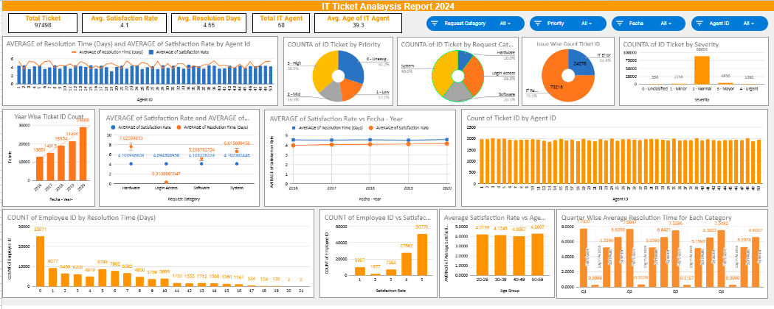
dashboard ON Google Sheet

Slide 23
Conclusion
Summary of Key Findings:
Customer Satisfaction Challenges: Identified specific areas where customer satisfaction is lacking, particularly related to ticket resolution times and agent knowledge gaps.
Market Opportunities: Highlighted potential new markets for expansion based on customer preference data and market saturation analysis.
Operational Inefficiencies: Noted inefficiencies in current ticket management processes that hinder performance.
Recap of Recommendations:
Enhance Agent Training Programs: Equip agents with necessary skills to improve customer interactions and resolution times.
Optimize Ticket Management Software: Upgrade to advanced software to streamline operations and improve data insights.
Expand Support Hours: Offer extended support to meet customer needs and improve accessibility.
Implications: Implementing these recommendations is expected to lead to increased customer satisfaction, enhanced operational efficiency, and expanded market share.

Slide 24
Acknowledgements and References
Acknowledgements:
I would like to express my gratitude to everyone who provided support throughout this project.
A special thanks to the online resources and communities that offered valuable insights and data.
I would also like to thank Newton School for their guidance and resources that significantly contributed to my understanding and execution of this project.
References:
Stack Overflow. (2023). Retrieved from https://stackoverflow.com
Cool article to do effective storytelling - https://www.analyticsvidhya.com/blog/2021/09/how-to-create-stunning-and-interactive-dashboards-in-excel/
How to do cool presentations - https://plumsolutions.com.au/five-rules-for-building-impressive-excel-dashboards/
YouTube Tutorials on Data Analysis. (2023). Retrieved from YouTube
preppindata to see sample dashboard https://www.preppindata.com/data-curious/it-support-ticket-analysis

